Slide 1
Chapter One
Software Design
Notes:
Software Design : Software design refers to the process of creating a specification of software artifact which will help to developers to implement the software. It is about designing individual modules/components means it defines what is module is performing, the classes, functions and their usages, etc. It is considered one of the initial phase of Software Development Life Cycle (SDLC).
Software Architecture : Software architecture refers to fundamental structure or the process of creating high level structure of a software system.

Slide 2
Topics
What is software design?
Objective of software design
Software Design Activities
Design considerations
Design principles
Introduction to User Interface Design

Slide 3
Software Design
What is a design?
-A process through which requirements are translated into a representation of software.
The process of converting the system specification into an executable system. Design is about how to build a system.
Design is the creative process of describing and transforming a problem into a solution.
Design is a problem-solving process whose objective is to find and describe a way: —To implement the system’s functional requirements... —While respecting the constraints imposed by the quality, platform and process requirements... - including the budget —And while adhering to general principles of good quality.

Slide 4
Cont’d…
Software design is an iterative process through which requirements are translated into a “blueprint” for constructing the software.
A blueprint is a reproduction of a technical drawing, documenting an architecture or an engineering design
Initially, the blueprint depicts a holistic view of software
Design is the first phase of transforming the problem into a solution
Design is highly creative stage in software development where the designer plans how the system or program should meet the customer’s needs and how to make system effective and efficient.

Slide 5
Stages of Design
Problem understanding
Look at the problem from different angles to discover the design requirements.
Identify one or more solutions
Evaluate possible solutions and choose the most appropriate depending on the designer's experience and available resources.
Describe solution abstractions
Use graphical, formal or other descriptive notations to describe the components of the design.
Repeat process for each identified abstraction until the design is expressed in primitive terms.
Notes:
Software design refers to the process of creating a specification of software artifact which will help to developers to implement the software. It is about designing individual modules/components means it defines what is module is performing, the classes, functions and their usages, etc. It is considered one of the initial phase of Software Development Life Cycle (SDLC).

Slide 6
The Design Process
Software designers do not arrive at a finished design immediately.
They develop design iteratively through number of different versions.
The starting point is informal design which is refined by adding information to make it consistent and complete.
Activities necessary for architectural designing.
• System Structuring
• Control modeling
• Modular decomposition

Slide 7
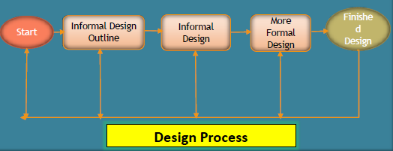
Cont…

Slide 8
Phases in the Design Process

Slide 9
Design Phases
Architectural Design: Identify sub-systems.
Abstract Specification: Specify sub-systems.
Interface Design: Describe sub-system interfaces.
Component Design: Decompose sub-systems into components.
Data structure Design: Design data structures to hold problem data.
Algorithm Design: Design algorithms for problem functions.

Slide 10
Objective of software design
Following are the purposes of Software design
Correctness: Software design should be correct as per requirement.
Completeness: The design should have all components like data structures, modules, and external interfaces, etc.
Efficiency: Resources should be used efficiently by the program.

Slide 11
Cont..
4. Flexibility: Able to modify on changing needs.
5. Consistency: There should not be any inconsistency in the design.
6. Maintainability: The design should be so simple so that it can be easily maintainable by other designers.

Slide 12
Software Design Activities
The 7 steps in design software design process activities
Step1: determining the issues
Step2: conducting extensive research
Step3: coming up with possible solution
Step4: assessing and identifying a real solution
Step5: developing and evaluating
Step6: debugging and evaluating
Step7: making changes to finished product

Slide 13
Cont.
The design should exhibit uniformity and integration – before design work begins rules of styles and format should be defined for a design team.
The design should be structured to accommodate change
The design should be structured to degrade gently, even when unusual data, events, or operating conditions are encountered.
The design should be assessed for quality as it is being created, not after the fact
The design should be reviewed to minimize conceptual (semantic) errors.

Slide 14
Design principles
Design Principle 1: Divide and conquer
Trying to deal with something big all at once is normally much harder than dealing with a series of smaller things
Design Principle 2: Increase cohesion where possible
A subsystem or module has high cohesion if it keeps together things that are related to each other, and keeps out other things
Design Principle 3: Reduce coupling where possible
Coupling occurs when there are interdependencies between one module and another

Slide 15
Cont..
Design Principle 4: Keep the level of abstraction as high as possible
Ensure that your designs allow you to hide or defer consideration of details, thus reducing complexity
A good abstraction is said to provide information hiding
Abstractions allow you to understand the essence of a subsystem without having to know unnecessary details
Design Principle 5: Increase reusability where possible
Design the various aspects of your system so that they can be used again in other contexts
Generalize your design as much as possible

Slide 16
Cont..
Design Principle 6: Reuse existing designs and code where possible
Design with reuse is complementary to design for reusability
Use reusable code and make code reusable
Design Principle 7: Design for flexibility
Actively anticipate changes that a design may have to undergo in the future, and prepare for them
Reduce coupling and increase cohesion
Create abstractions
Do not hard-code anything
Leave all options open —Do not restrict the options of people who have to modify the system later

Slide 17
Cont..
Design Principle 8: Anticipate obsolescence
Plan for changes in the technology or environment so the software will continue to run or can be easily changed
Avoid using early releases of technology
Avoid using software libraries that are specific to particular environments
Design Principle 9: Design for Portability
Have the software run on as many platforms as possible • Avoid the use of facilities that are specific to one particular environment
Design Principle 10: Design for Testability
Take steps to make testing easier • Design a program to automatically test the software

Slide 18
Cont…
Design Principle 11: Design defensively
Never trust how others will try to use a component you are designing • Handle all cases where other code might attempt to use your component inappropriately

Slide 19
Principles Leading to Good Design
Overall goals of good design: • Increasing profit by reducing cost and increasing revenue • Ensuring that we actually conform with the requirements • Accelerating development • Increasing qualities such as
Usability
Efficiency
Reliability
Maintainability
Reusability

Slide 20
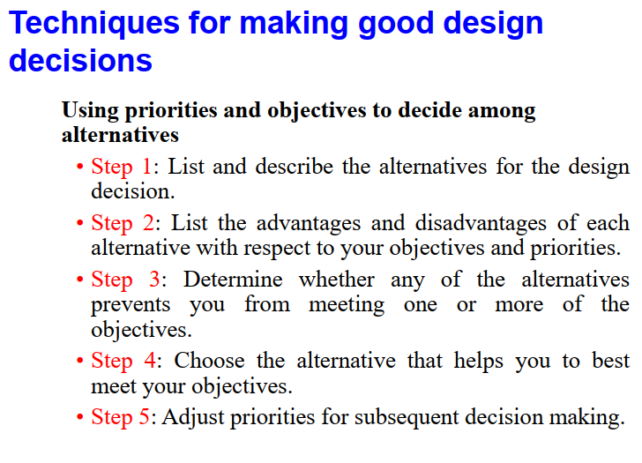

Slide 21
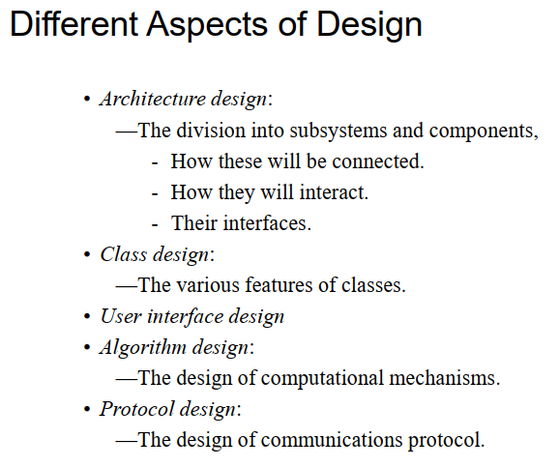

Slide 22
Software Design Concepts
Every software process is characterized by basic concepts along with certain practices or methods.
Methods represent the manner through which the concepts are applied.
As new technology replaces older technology, many changes occur in the methods that are used to apply the concepts for the development of software.
However, the fundamental concepts underlining the software design process remain the same, some of which are described here

Slide 23
Basic concepts
Abstraction: Data, Functional, control
Refinement: Elaboration of detail for all abstractions
Modularity: Compartmentalization of data and function
Functional Independence: Single-minded function and low coupling
Information Hiding: Controlled interfaces
Architecture: Overall structure of the software
Patterns: Convey the essence of a proven design solution
Refactoring: Reorganization technique that simplifies the design

Slide 24
Abstraction
Allows designers to focus on solving a problem without being concerned about irrelevant lower level details.
There are three commonly used abstraction mechanisms in software design
Functional abstraction: This involves the use of parameterized subprograms. Functional abstraction can be generalized as collections of subprograms referred to as groups.
Data abstraction: This involves specifying data that describes a data object. For example, the data object window encompasses a set of attributes (window type, window dimension).

Slide 25
Cont..
3. Control abstraction: This states the desired effect, without stating the exact mechanism of control.
This refers to the software part of abstraction wherein the program is simplified and unnecessary execution details are removed
For example, if and while statements in programming languages (like C and C++) are abstractions of machine code implementations.

Slide 26
Refinement
Process of elaboration where the designer provides successively more details for each design component
It is a process where one or several instructions of the program are decomposed into more detailed instructions.
Stepwise refinement is a top down strategy.
Software designers start the stepwise refinement process by creating a sequence of compositions for the system being designed.
Each composition is more detailed than the previous one and contains more components and interactions.
Abstraction and refinement are complementary features:
one specifies procedure and data without details;
other allows to elaborate by providing low-level details.

Slide 27
Modularity
In this concept, software is divided into separately named and addressable components called modules
Modularity is the degree to which software can be understood by examining its components independently of one another.
Follows divide and conquer concept, a complex problem is broken down into several manageable pieces
A complex system is partitioned into a set of discrete modules in such a way that each module can be developed independent of other modules.
Modules are integrated together to meet a requirements.
NB: larger the number of modules a system is divided into, greater will be the effort required to integrate the modules.

Slide 28
Advantage of modularization
Smaller components are easier to maintain
Program can be divided based on functional aspects
Desired level of abstraction can be brought in the program
Components with high cohesion can be re-used again
Concurrent execution can be made possible.
Desired from security aspect.

Slide 29
Modular Design Method Evaluation Criteria
Modular decomposability - provides systematic means for breaking problem into sub problems
Modular composability - supports reuse of existing modules in new systems
Modular understandability - module can be understood as a stand-alone unit
Modular continuity - side-effects due to module changes minimized .
Modular protection - side-effects due to processing errors minimized

Slide 30
Functional independence
Each module should address a specific sub function of requirements and have a simple interface.
Functional independent modules are easier to develop, maintain, and test.
Module perform a single task and little interaction with other
Error propagation is reduced and reusable modules are possible;
Assessed using two qualitative criteria:
Coupling: Relative interdependence among modules
Cohesion: Relative functional strength of a module
Coupling: Two modules are considered independent if one can function completely without the presence of other.

Slide 31
Coupling
Degree to which a module is connected to other modules in the system
The more connections between modules, the more dependent
To solve and modify a module separately, we would like the module to be loosely coupled with other modules.
Two components can be dependant in many ways:
References made from one to another
Amount of data passed from one to another
Amount of control one has over the other
The complexity of the interface
The type of information flow between modules

Slide 32
There are five levels of coupling
Data coupling- Data coupling is when two modules interact with each other by means of passing data (as parameter). If a module passes data structure as parameter, then the receiving module should use all its components.
Stamp coupling- When multiple modules share common data structure and work on different part of it.
Control coupling- Two modules are called control-coupled if one of them decides the function of the other module or changes its flow of execution.
Common coupling- When multiple modules have read and write access to some global data.
Content coupling - When a module can directly access or modify or refer to the content of another module.

Slide 33
Cohesion
Degree to which a module performs one and only one function
All elements of component are directed toward performing the same task.
Cohesion of a module gives the designer an idea about whether the different elements of a module belong together in the same module.
Cohesion and coupling are clearly related.
Usually the greater the cohesion of each module in the system, the lower the coupling between modules is.

Slide 34
There are several levels of Cohesion:
Functional:-all the elements of the module are related to performing a single function. Functional is the strongest cohesion
Sequential:-When the elements are together in a module because the output of one forms the input to another
Communicational:-has elements that are related by a reference to the same input or output data
Procedural:-contains elements that belong to a common procedural unit.
Temporal:-is the same as logical cohesion, except that the elements are also related in time and are executed together.
Logical:-if there is some logical relationship between the elements of a module, and the elements perform functions that fill in the same logical class.
Co-incidental: occurs when there is no meaningful relationship among the elements of a module.

Slide 35
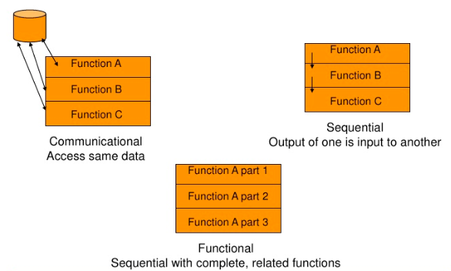
Cont…

Slide 36
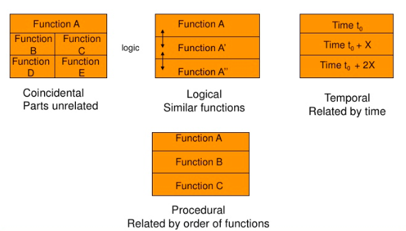
Example

Slide 37
Information Hiding
A good split of modules is when modules communicate with one another with only the information necessary to achieve the software function.
Enforces access constraints to
Procedural details with a module
Local data structure used by that module
Benefits
Reduces the likelihood of “side effects”
Limits the global impact of local design decisions
Emphasizes communication through controlled interfaces
Discourages the use of global data
Leads to encapsulation—an attribute of high quality design
Results in higher quality software

Slide 38
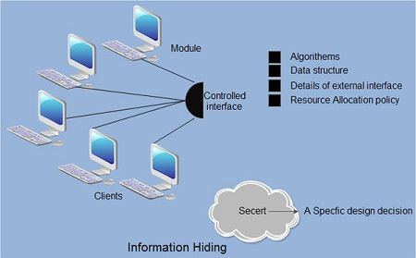
Cont…

Slide 39
Refactoring
” Refactoring is the process of changing a software system in such a way that it does not alter the external behavior of the code, yet improves its internal structure”, M. Fowler
Refactoring a software means examining the existing design for:
Redundancy
Unused design elements
Inefficient or unnecessary algorithms
Poorly constructed or inappropriate data structures
Any other design failure that can be corrected to yield a better design

Slide 40
Introduction to User Interface Design
User interface design plays an important role in determining how people interact with a software product.
This is because UI design has to do with how different visual elements, such as colors, typography, and imagery, work together to create a seamless user experience.
There are three main types of UI design

Slide 41
Cont..
Graphical user interfaces (GUI): It concerns the visual interfaces we see on our computers and handheld devices, such as websites and app screens.
Voice-controlled interfaces: These interfaces require sounds, specifically voices, to initiate action. A classic example of this type of interface is Apple's Siri.
Gesture-based interfaces: These interfaces are motion-activated and used for applications such as virtual reality games.

Slide 42

Thank You!

